Slide 1
Uml Diagrams

Slide 2
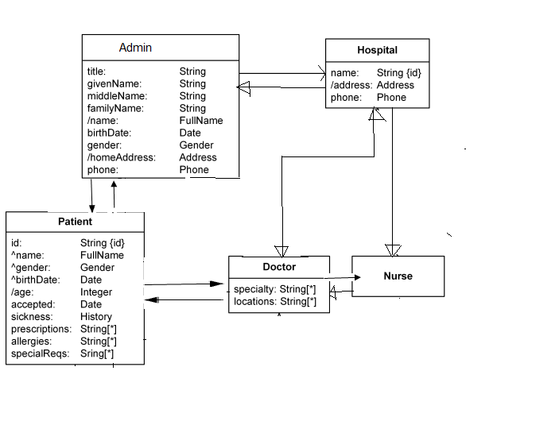
Class diagram

Slide 3
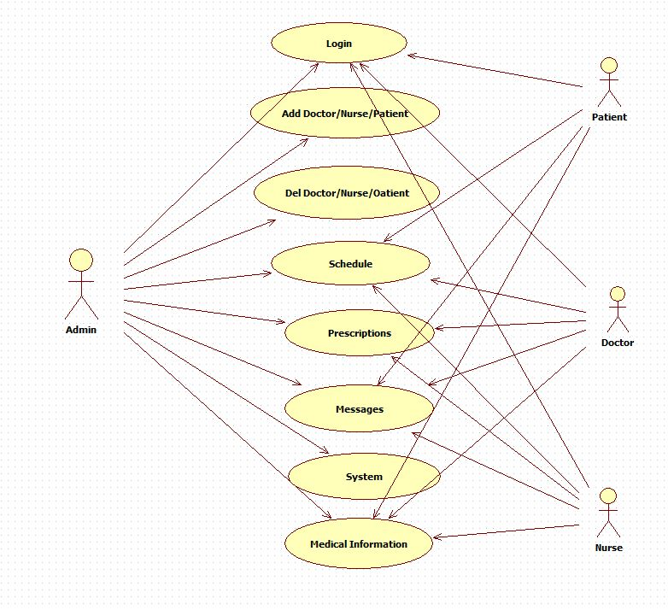
Usecase diagram

Slide 4
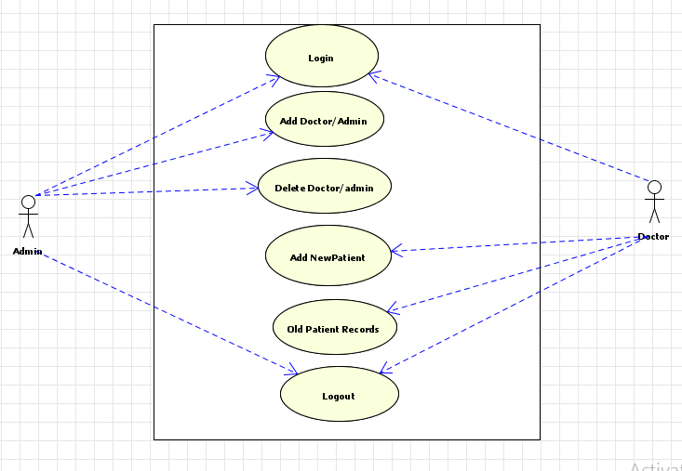

Slide 5
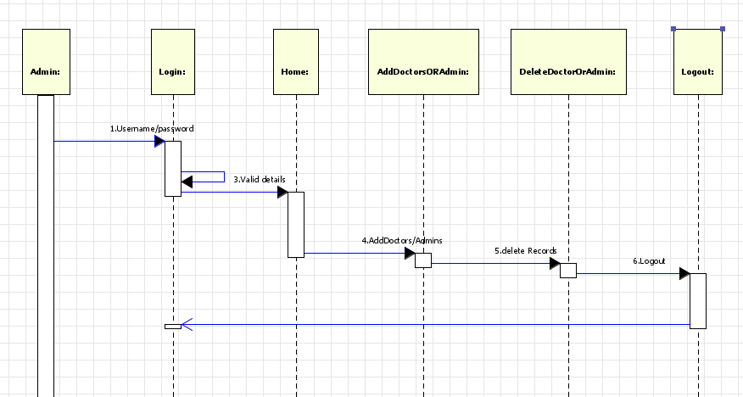
Sequence diagram

Slide 6

State chart diagram

Slide 7
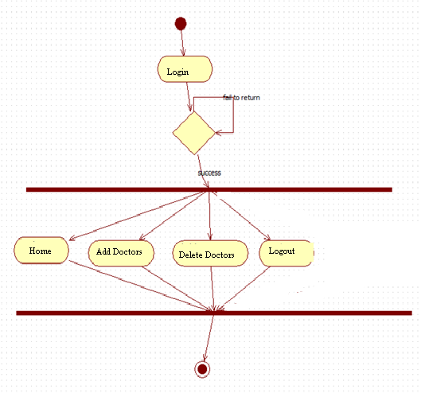
Activity diagram

Slide 8
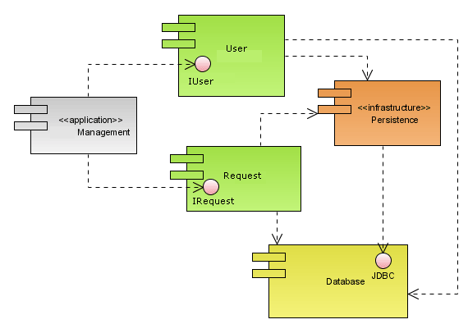
Component diagram

Slide 9
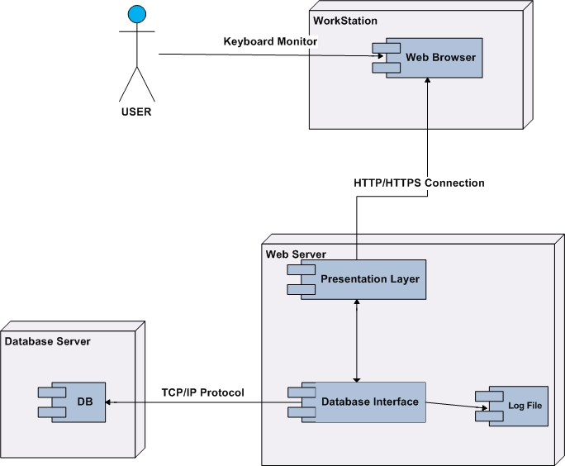
Deployment diagram

Slide 10
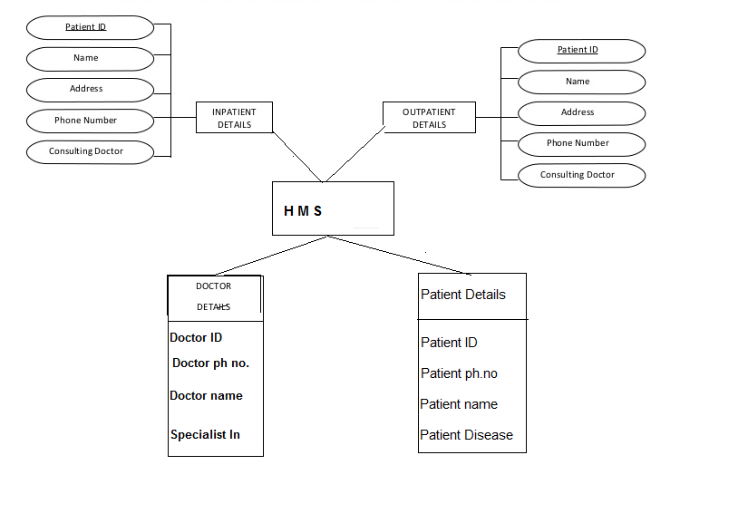
ER diagram

